Slide 1
Final Project - Churn
אמה גולדברג, ת"ז 211540240
עומר מעתוק, 207939943
ליאור בס, ת"ז 204684179

Slide 2
Part A - Python

Slide 3
The Problem
In our project, we try to predict the likelihood that customers will leave the service they subscribed to based on service providers, the products they consume, additional services, and payment methods in full detail.
The "churn" column is the column that provides us with information on whether the customer has "left" the service they subscribed to or not. The provided data details the life span and services of each customer, including information on the entire package they pay for and what it includes in terms of phone and internet services, service provider, payment methods, and more.
The ability to analyze whether a customer will "leave" the service they receive based on the behavior patterns of all the documented customers in the data can allow us to predict our future revenue cycle based on the customers who will continue to use the service they subscribed to.

Slide 4
Data Description
We have data on 7043 customers over all time, but only 5174 of them have not left the service (73.46%). We divided these customers into 80% train and 20% test.
The information about all customers is detailed in 21 columns –
An ID column for each customer
Personal information about the customers (gender, senior citizen, partner, dependents)
their "lifetime" in months in the detailed services about them.
Phone service and the number of lines they pay for
Internet service and details about security, backup, device protection, and technical support.
TV and movie streaming services
Information about the payment method detailing contract type, paperless billing, payment method, monthly charge amount, and total charges.
Churn column – whether a customer left the service or not.
In the data, in the total charges column, there are 11 rows with missing values.

Slide 5
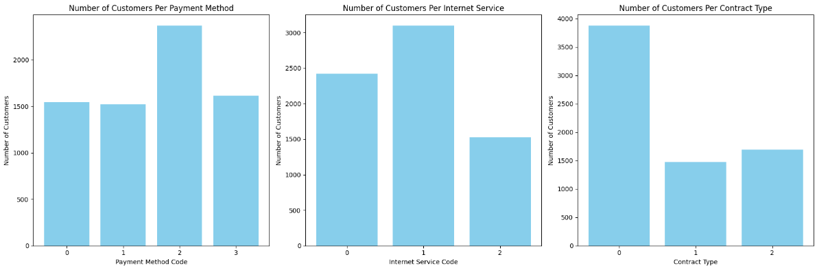
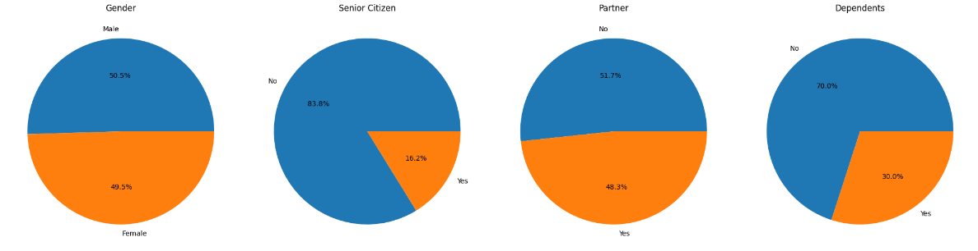
Data Description

Slide 6
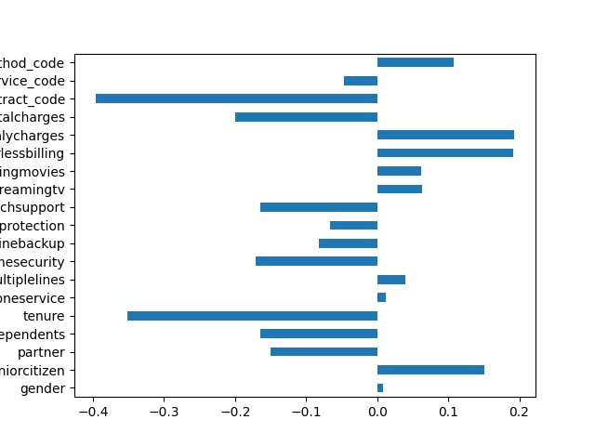
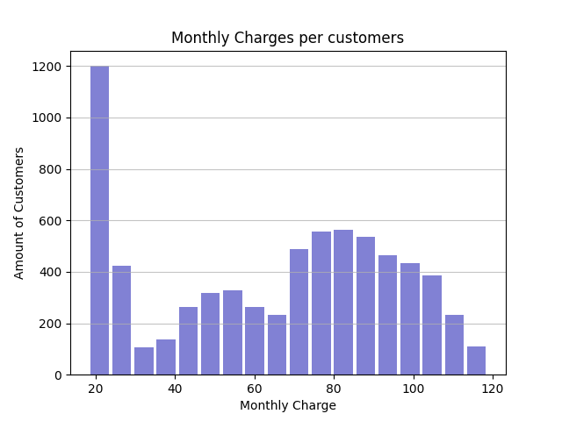
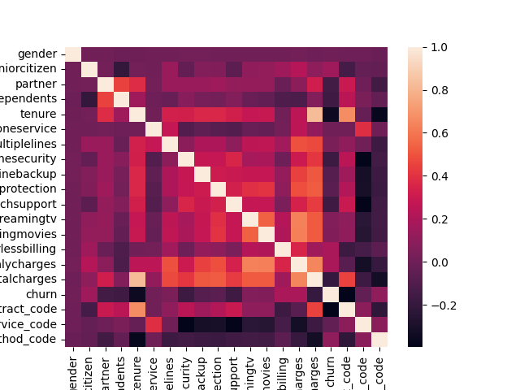
Data Description

Slide 7

Data Engineering
In our data, there were 3 columns with more than two recurring values. We converted the values written in object format into new columns with numerical values. We deleted the original columns because we will not be able to use text for data analysis later.
contract – {0: 'Month-to-month', 1: 'One year', 2: 'Two year’}
internetservice – {0: 'DSL', 1: 'Fiber optic', 2: 'No’}
paymentmethod – {0: 'Bank transfer (automatic)', 1: 'Credit card (automatic)', 2: 'Electronic check', 3: 'Mailed check’}
In the total charges column, we filled the missing values using the mean().

Slide 8
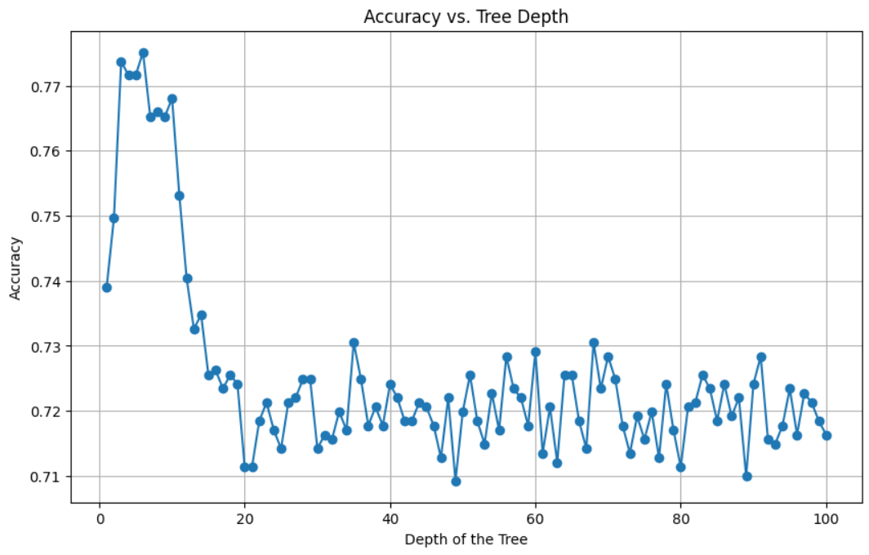
ML Algorithms: testing algorithms of Decision tree
We built a loop that checks the most accurate maximum depth between 1 and 100. Using a visual simulation on an axis, we can see the three depth values that provide the most accurate rates. We chose depths – 6, 3, and 5.

Slide 9
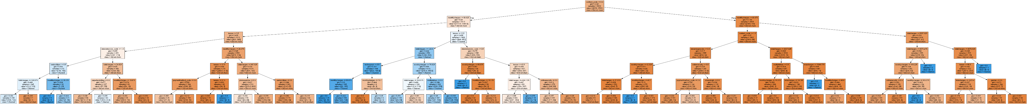
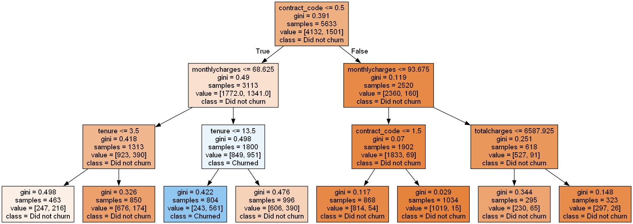
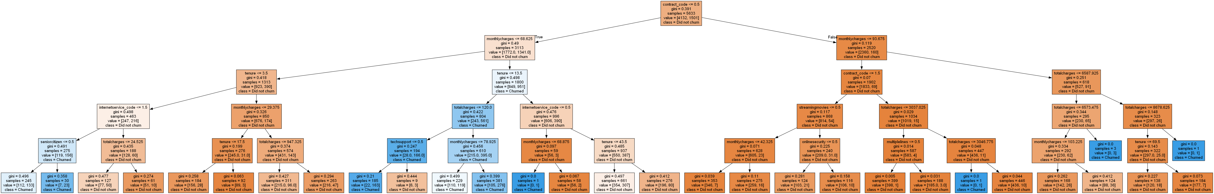
Decision trees visualizations
Option 1 – depth 6
Accuracy score:0.775886524822695
Option 2 – depth 3
Accuracy score:0.7737588652482269
Option 3 – depth 5
Accuracy score:0.7716312056737589

Slide 10
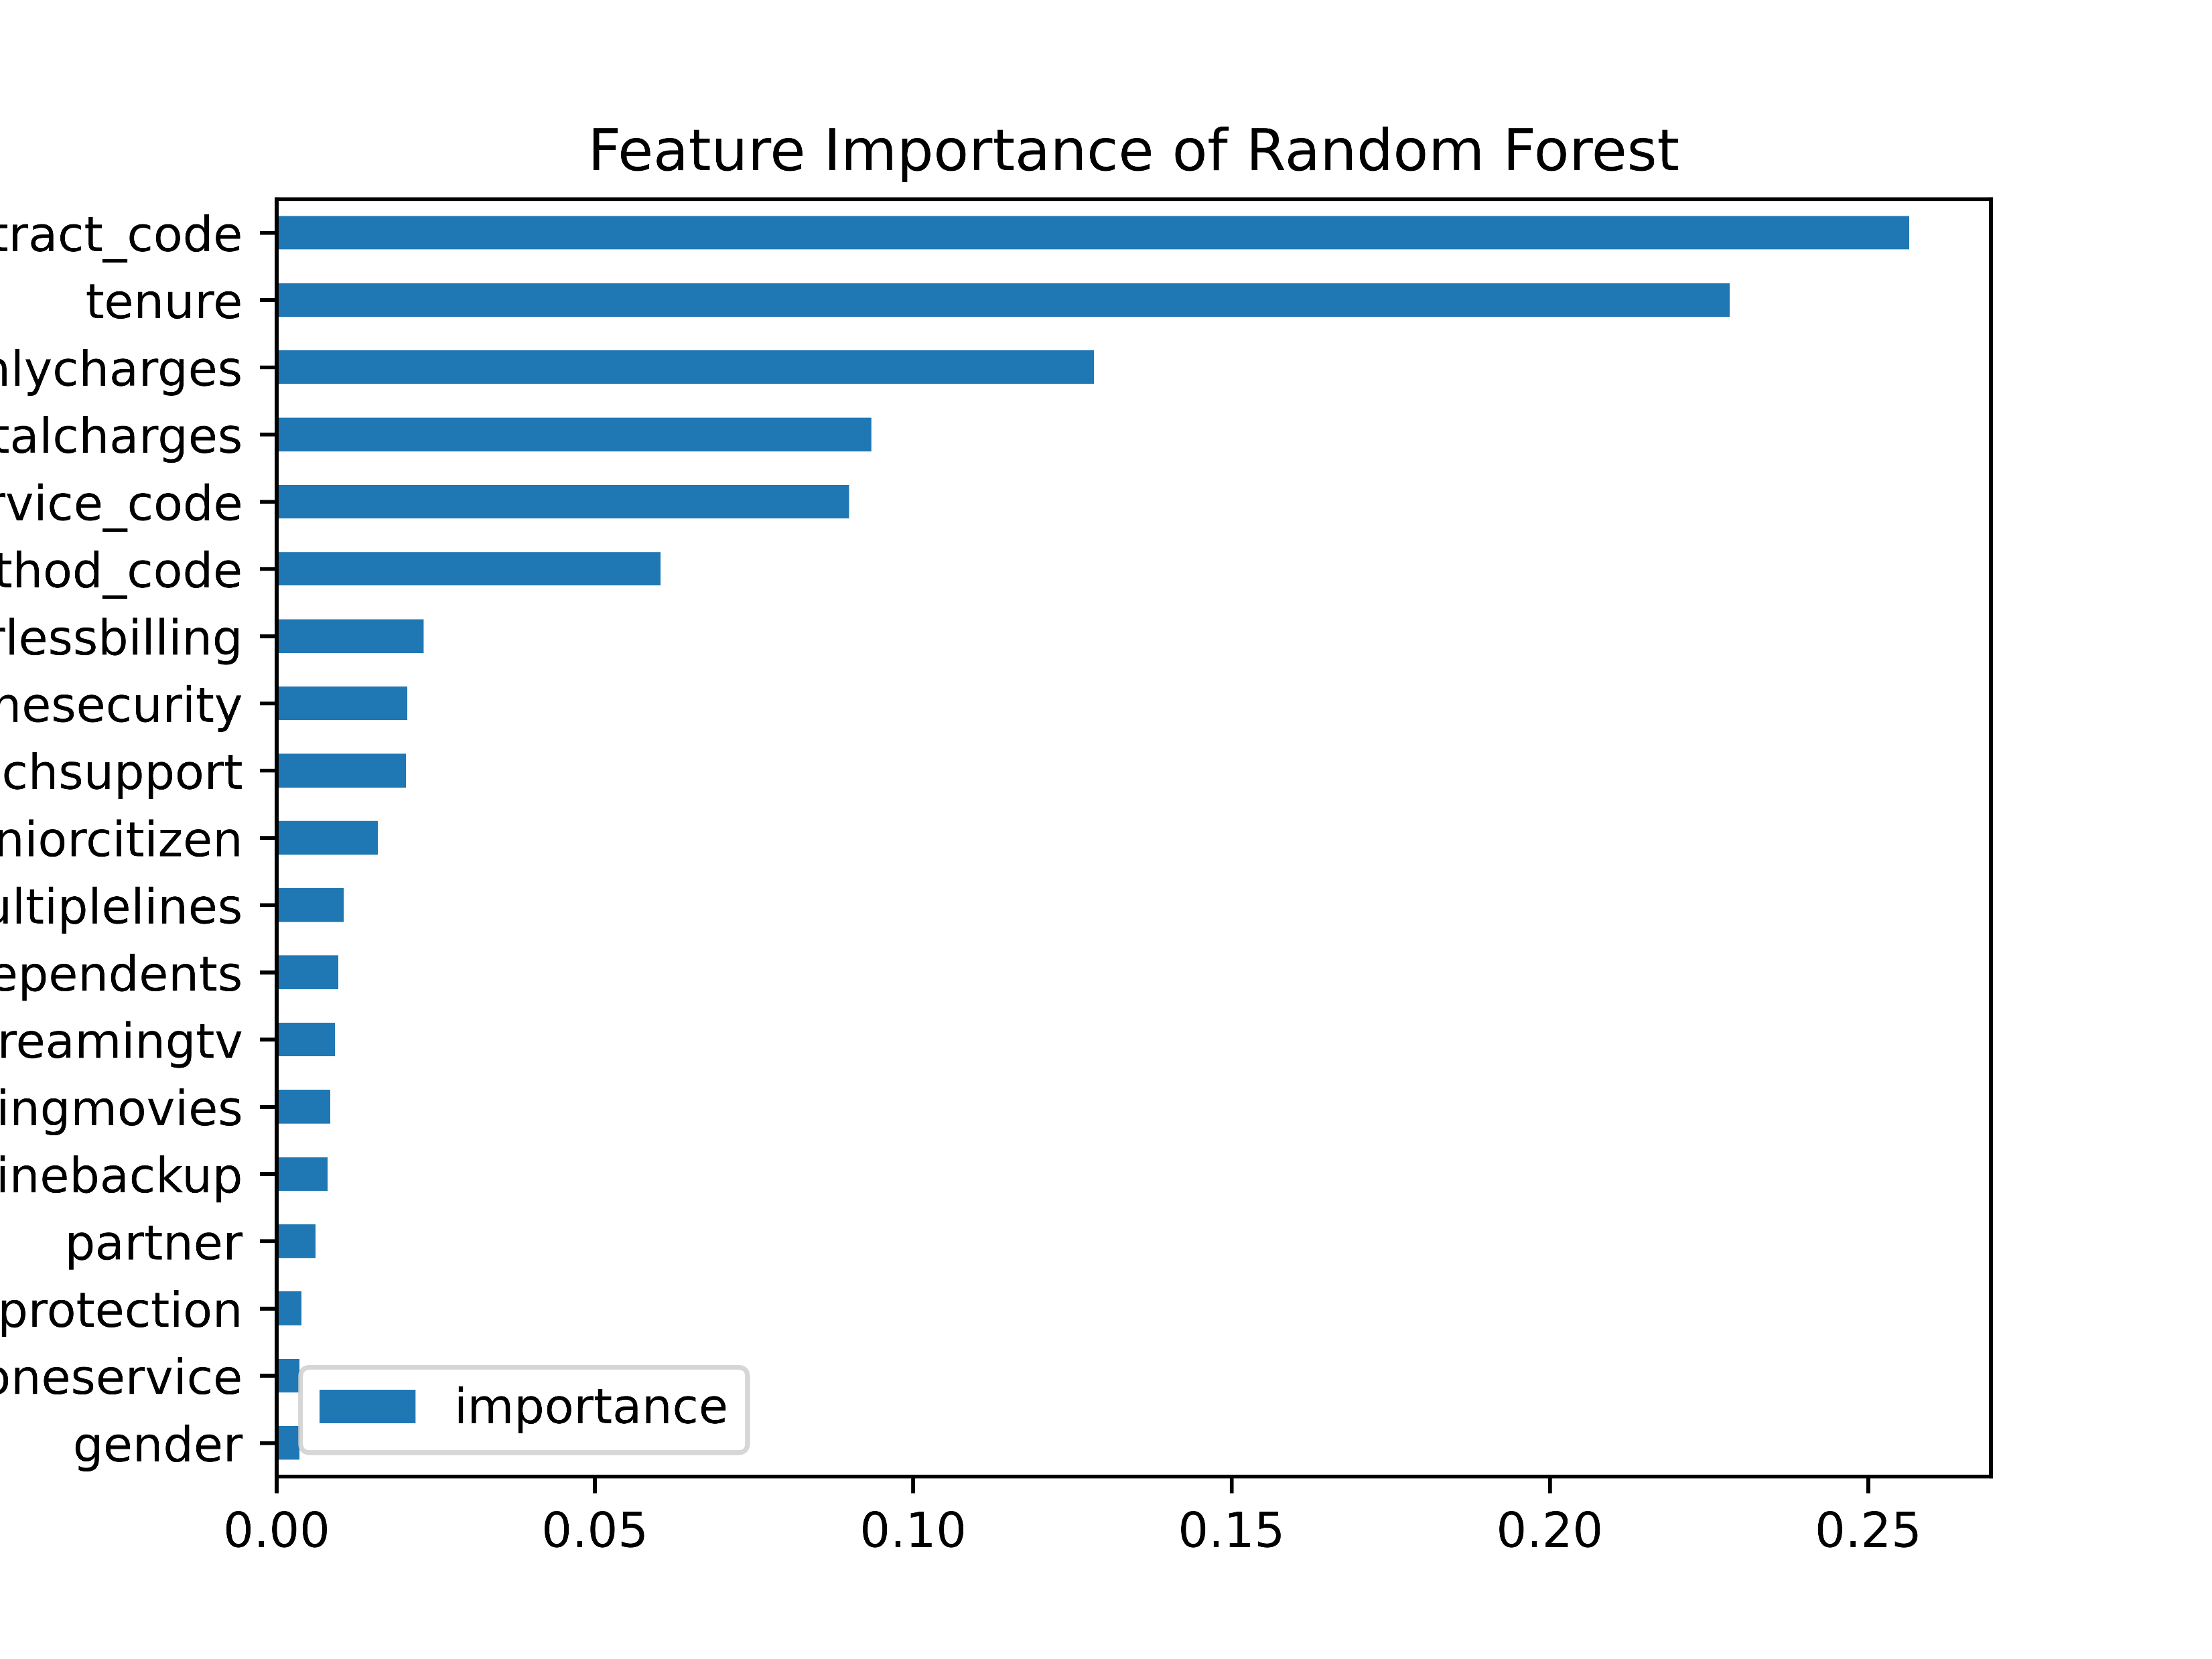
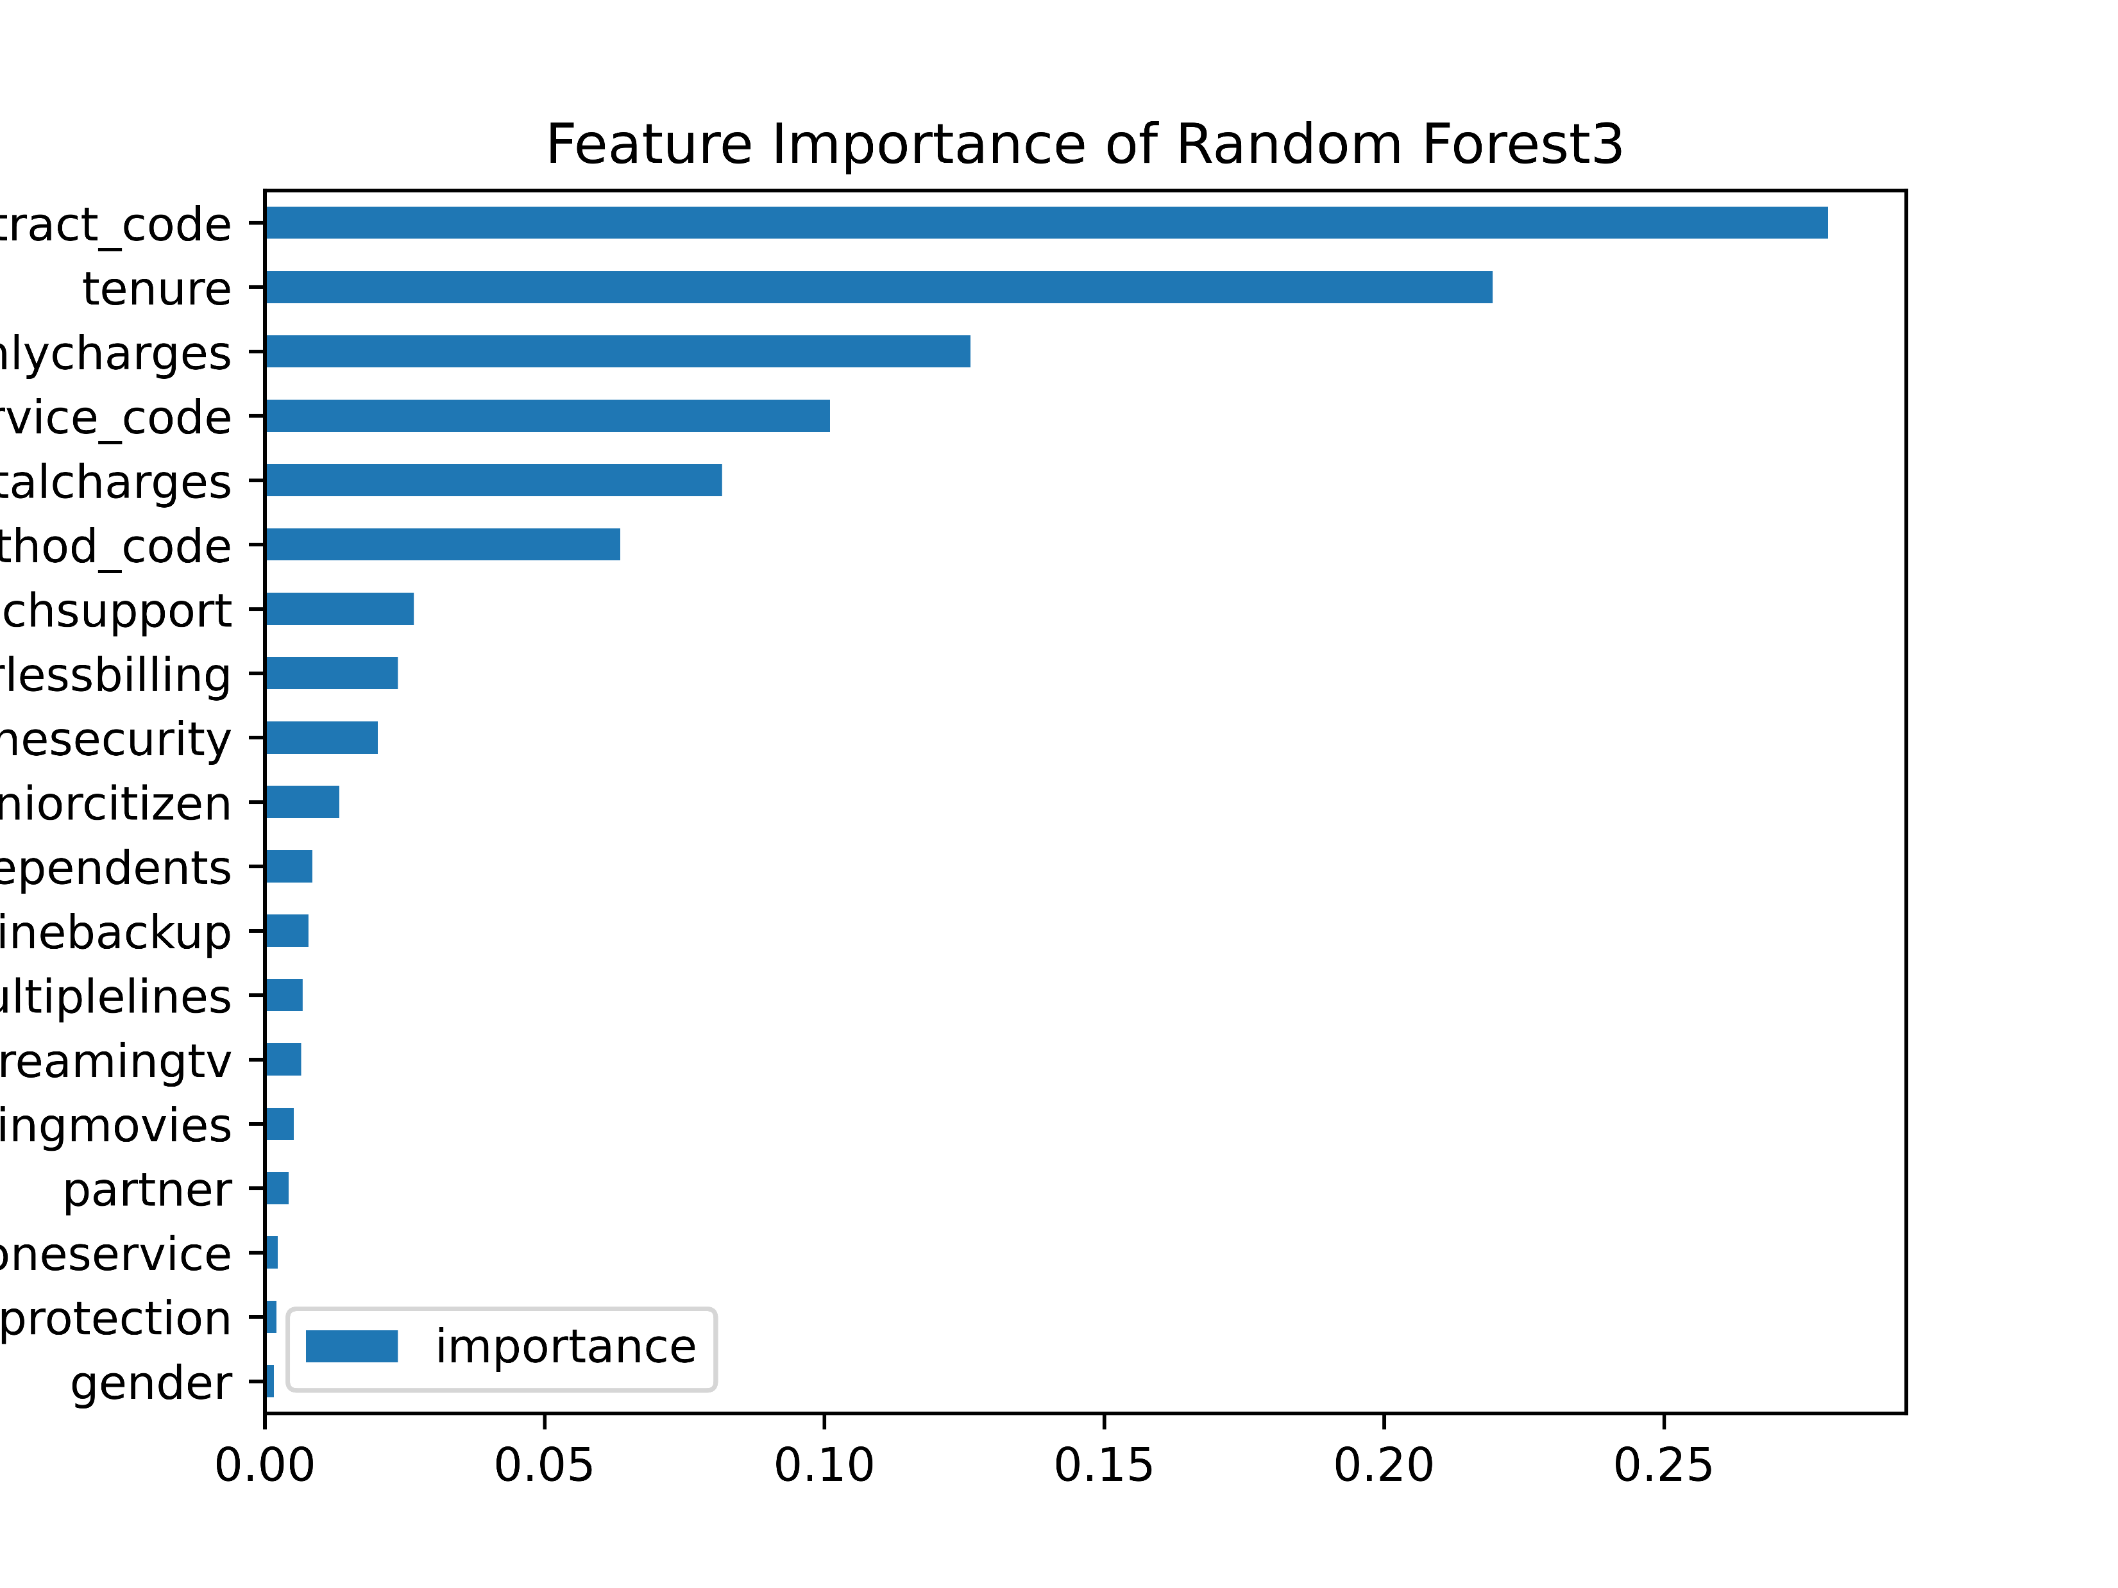
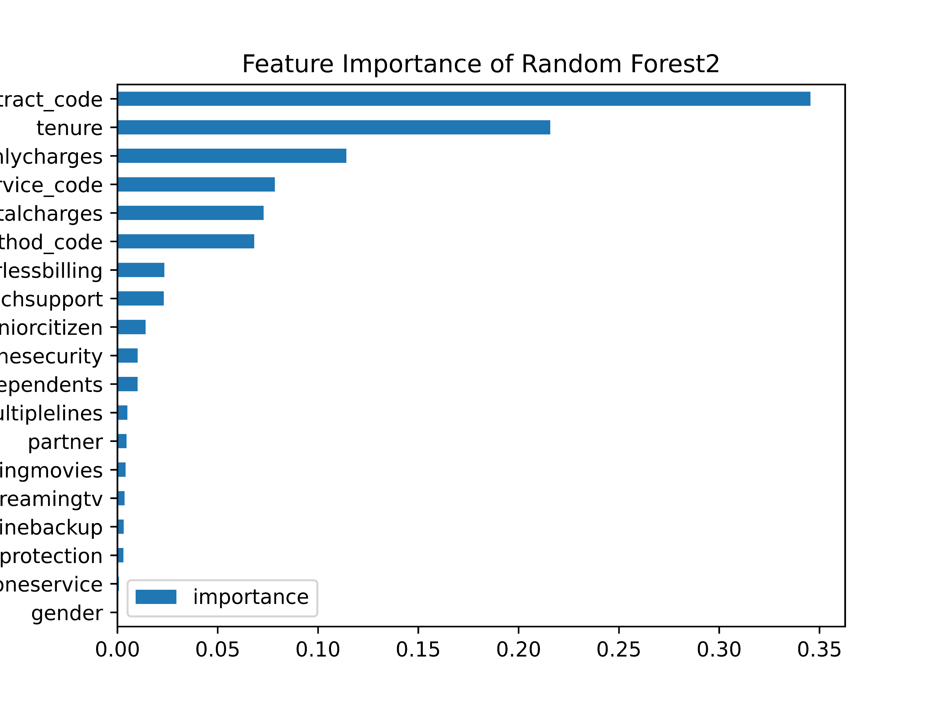
ML Algorithms: testing algorithms of Random forest
Based on the depth results we obtained from performing the Decision Trees that provide the most accurate prediction rate of whether a customer will churn or not, we built 3 different options for Random Forests based on these depths – (6, 3, and 5). In all three options, we received the same prediction rate.
Option 1 – depth 6
Option 3 – depth 5
Option 2 – depth 3
Accuracy score:0.7929078014184398
Accuracy score:0.7929078014184398
Accuracy score:0.7929078014184398

Slide 11
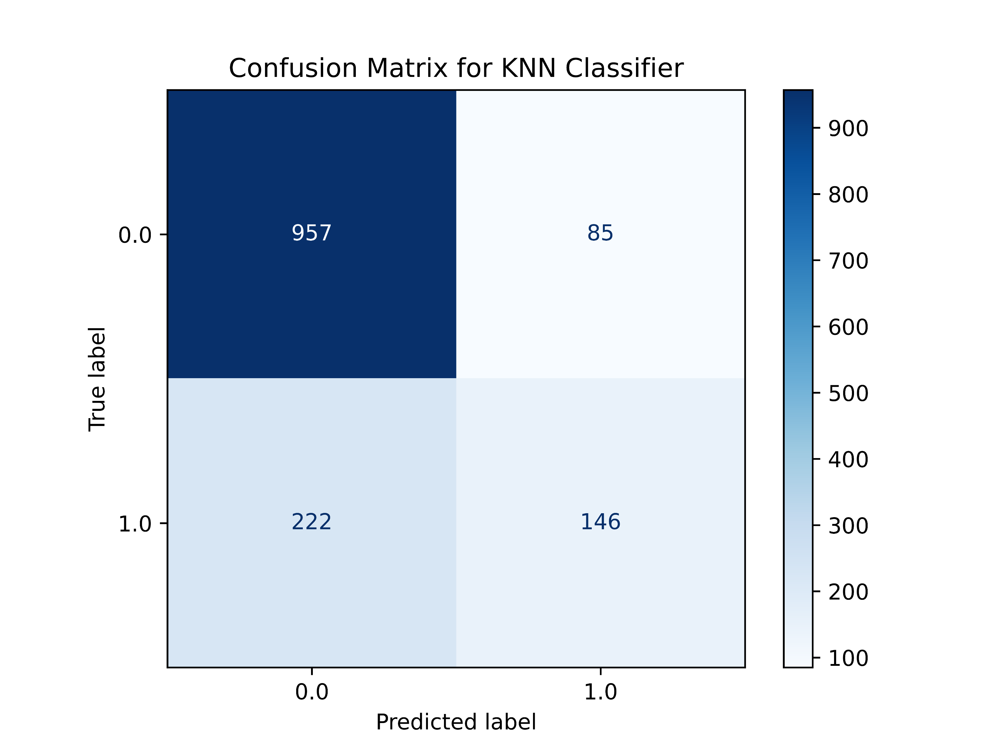
ML Algorithms: testing algorithms of K nearest neighbors
`We built a loop that checks the prediction rate based on the "neighbors" near it, ranging from 1 to 50 neighbors, and returns the three options with the highest prediction rate.
These are the top three results we obtained:
Top 1 n_neighbors is 23 with an accuracy of 0.7823
Top 2 n_neighbors is 25 with an accuracy of 0.7816
Top 3 n_neighbors is 21 with an accuracy of 0.7816
Confusion Matrix for 23 neighbors,
Accuracy of 0.7822695035460993

Slide 12
Algorithms introspection – inspecting various algorithm’s artifacts
We chose a Decision Tree with a depth of 6 because its accuracy was the highest at 0.7758.
However, despite having the highest accuracy score, the algorithm that gives us the highest prediction score overall is the Random Forest, where we found that regardless of the depth chosen (6, 3, or 5), we achieved the same highest prediction score of 0.7929.
Based on the visualizations we created with the Random Forest, we can see that the most influential feature on whether a customer churns or not is the Contract, followed by Tenure, Monthly Charges, etc.
(Attached: Feature importance from Random Forest - depth 6)

Slide 13
Changes that were made in part A
For Part B, We decided to export the ML Model of K nearest neighbors with 23 neighbors. We used pickle to do the export of our model.
At the end of the code, we added mapping for each column that we used the label encoder with, for us to remember what the values are and show it later in the visualization.

Slide 14
Part B - MongoDB

Slide 15
Workflow in MongoDB
We created in MongoDB a new database which contained a collection based on the Json file provided.
In MongoDB compass we analyzed the scheme to get a more detailed look the data given to us, and simultaneously we opened a new notebook, imported PyMongo (and Pickle from part A) and connected to MongoDB.
We cleaned all the data given for part B like we did in part A, then we imported our chosen ML Model using pickle. We made sure all the expected features the model imported are provided in the new data and ran the prediction on our new customers.
Then, we checked the results and see that 0% of our customers are predicted to leave they use currently.
Joined our new predictions to the DataFrame with all the information about the customers and exported it as a new csv file that is ready to use in the next parts.

Slide 16
Part C - Spark

Slide 17
Workflow with Spark
In a Colab notebook we imported spark and connected to our drive where we saved our new data given for part C - which included the new customer’s rating and countries.
For start, we checked to see what’s the data given and started the cleaning process stripping our long dictionaries given into columns based on the first row in the data and create a DataFrame.
Continuing to clean the data - dropping duplicate values, cleaning our strings from any unwanted symbols and made sure our country column is ready to use pycountry.
We used pycountry with a “findCountryFuzzy” function to identify the customers countries,
And filled all null values with “unknown” .
Finally, exported all the clean data to a csv file after changing the rating column to Float instead of string.

Slide 18
Part D - Tableau

Slide 19
Workflow with Tableau Prep
To easily work with Tableau Prep, we renamed our files from parts B and C, and connected to them using Google Drive.
We took the data from part B and brought it 4 different times to create 3 dim tables from it – Customers, Services and Contract.
For the fourth time we’ve joined the columns needed for the Fact table with the csv file from part C which contained each customers rating and country. (Using Left Join – to keep all the customers from part B).
We prepared the data for visualization by changing all the Boolean values back to yes and no, all our columns we used the label encoder in part A – were changed back to the original values and we created from each table a CustomerBK that eventually we turned into a CustomerSK using a calculated field.
After making sure all the 3 dim tables and Fact tables are ready, we joined all the tables to build a star schemed model.
For each table – there was a hyper file created, as well as an extract for the connections and a csv file for us to check on the fact table

Slide 20
Workflow with Tableau Desktop
In Tableau Desktop we established our connections using the hyper files that we extracted.
Made sure our relationships are accordingly and looked at our data again to see that everything is accordingly.
Because the churn rate we got is 0.0% we decided to focus in our visualizations on 3 main dashboards –
1. Contract Dashboard
2. Ratings by country
3. Services Dashboard

Slide 21
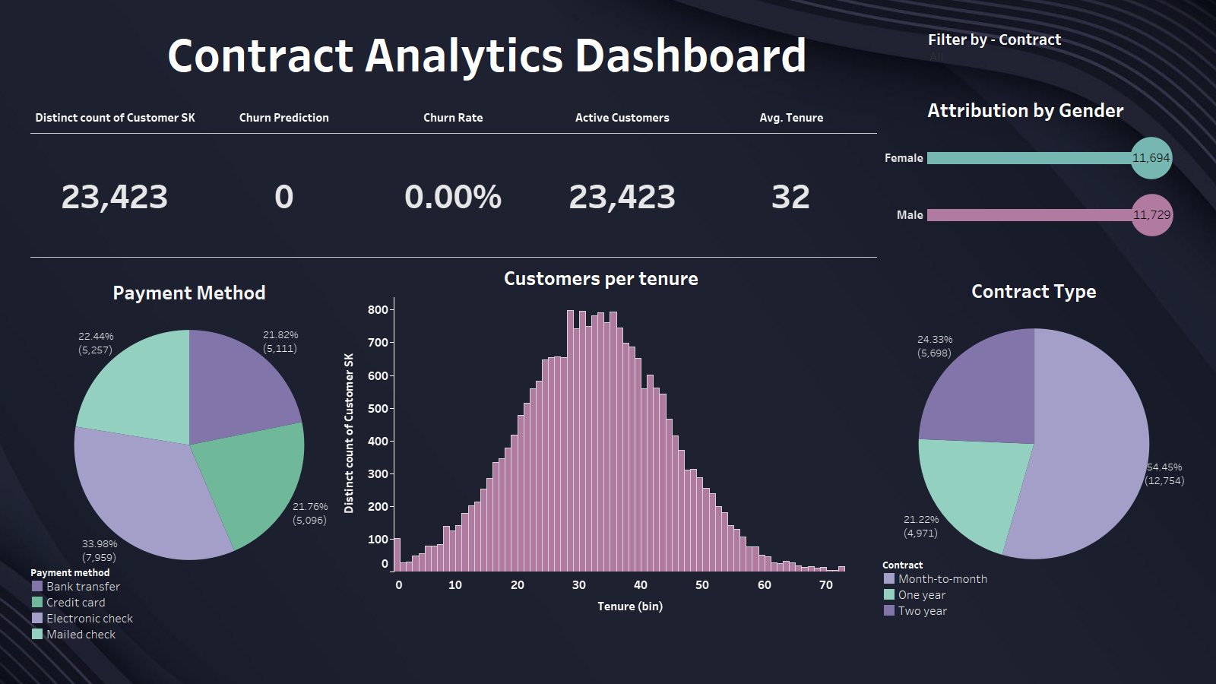
Contract Dashboard
Above, we show our KPI’s in terms of churn – we see that our rate is 0.00%.
Underneath we can see more about our customers – what contract type they pay based on and what are the selected payment method ratio between our customers.
A bar chart of the customers per tenure is added – to give us an idea of our customers lifetime of using our product.
All the dashboard can be affected with filtering by gender (it’s not giving us a lot in terms of change in the data but we can learn from it as well),

Slide 22
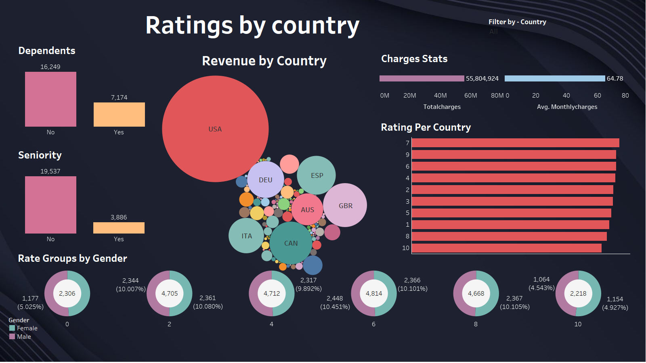
Ratings by country
In this dashboard, we decided as a default view – to show our top 10 countries revenue wise and the ratings given by their customers. We decided to visualize the ratings in a bar chart as well as in a lollipop graphs of rate groups.
On the top right corner we can filter by country our view, right below it is our total charges and the average monthly charges
Accommodated with some specifications about our customers – seniority and dependents.

Slide 23
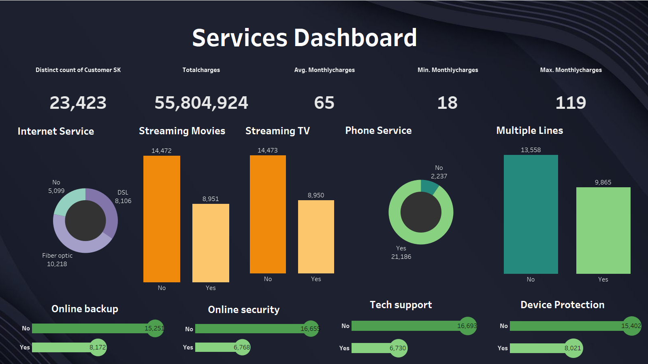
Services Dashboard
In the services dashboard, we take a deep look at the nature of our customers' use of our services.
What are the minimum and maximum our customers pay – as well as the average.
We can see via the charts that most of our customers use a phone service, and we have more customers that use a single phone line rather than multiple lines.
The most used internet service is Fiber Optic.
We have more customers that don’t use our streaming services (whether it’s TV or movies).
And, we have more customers that don’t use our online backup, online security, tech support, and device protection – rather than customers who do.

Slide 24
Conclusions
From all the data we analyzed and visualized we can conclude that our customers are an equal amount of each gender, the mass majority are not seniors – and most of them don’t have dependents.
The payment methods vary but the most common contract type is based on month-to-month. The monthly charges go between 18 being the minimum and all up to 119.
We got a variety of rating between 1-10 which shows us a picture that overall, our customers are satisfied with their subscription and services provided.
We based the prediction on the model of K nearest neighbors of 23 and Our churn rate for all the customers in the data given is 0.00%. From everything we analyzed we can understand why this is the rate we got.

Slide 25
What we can do from here
With all the conclusion being said and our churn rate on 0.00%, we should still focus on retaining our customers and offer them a wider glimpse of the services we can provide them – that they are currently not using.
Whether it’s joining our phone and internet services, use our streaming for TV and movies, or even use our products of online backup, online security, tech support and device protection.
The more services we offer to our customers, the more ways we can retain them and ensure our churn rate will stay at 0.00%

